Slide 1
PRAGMA Overview and
Future Directions
Workshop on Building Collaborations in Clouds, HPC and Applications
17 July 2012

Slide 2
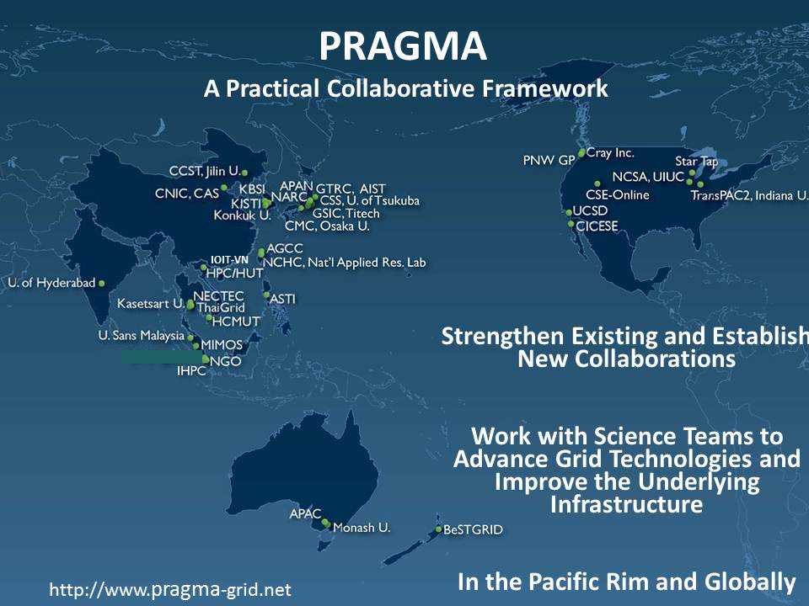
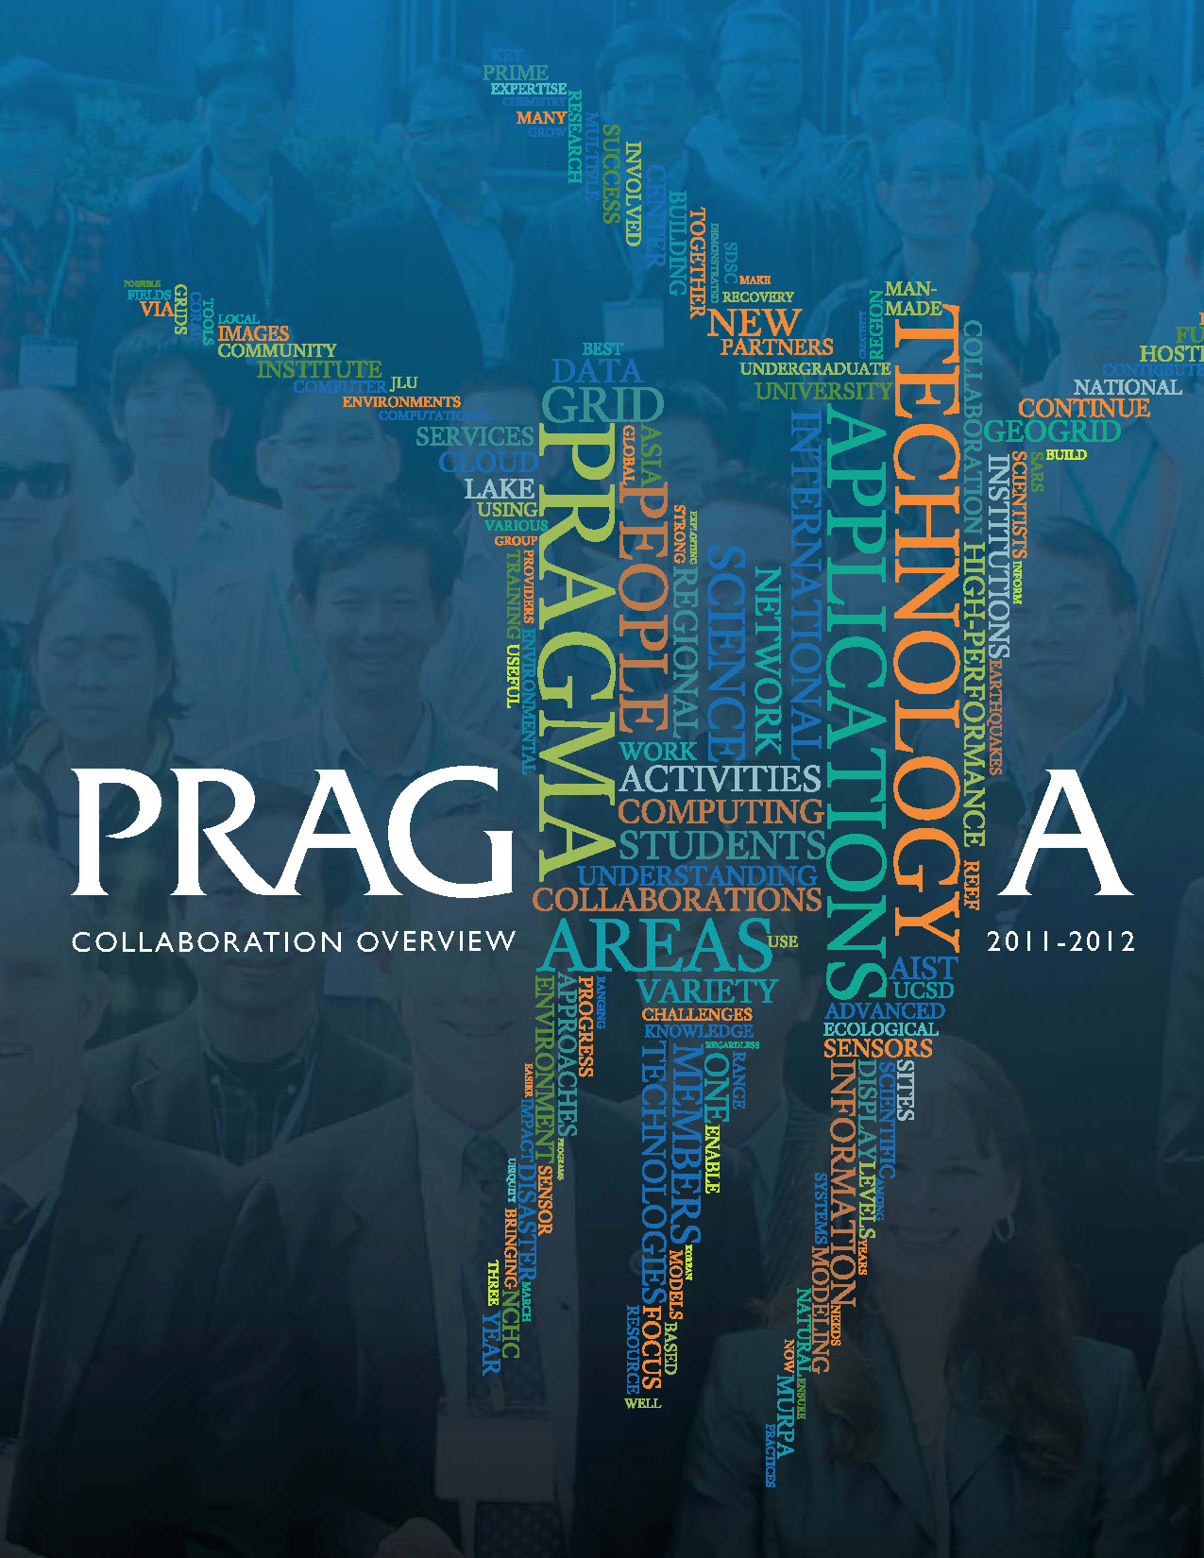
Pacific Rim Application and Grid Middleware Assembly
PRAGMA: 10 Years of Collaboration and Experimentation
Built and used multi-provider cloud testbed
Driven development via Scientific Expeditions
Engaged new groups
It’s the People
PRAGMA 20 at HKU
Centennial Celebration
March 2011
Network of People

Slide 3
Collaborative Opportunities
Motivation
  New ideas
  Broader testbed and improved software
  Additional and improved scientific expeditions
  Greater opportunities for researchers and students
Potential Areas
  Virtualization
    Compute
    Networking
  Environmental Observing and Monitoring Systems
  Disaster Recovery
  Biosciences
  Software development
  Student exchange
PRAGMA 23 in Seoul, Korea
Host Konkuk University
9 – 11 October 2012

Slide 4
Other Collaborative Opportunities
China US Software Research
  Build collaborative research teams in software research
  http://www.nsf-nsfc-sw.org/
Open Source DataTurbine Initiative
  Develop technology for scaling sensor networks
  Real-time streaming data middleware for embedded and mobile computing applications
  http://www.dataturbine.org/
RCN4GSC (Genome Standards Consortium)
  From Genomes to Interactions to Communities to Models – held at BGI in Shenzhen 2012 March 4-7
  Beijing Meeting ????
  http://gensc.org/

Slide 5
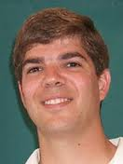

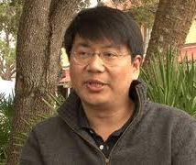
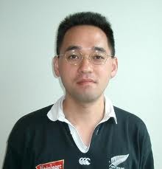
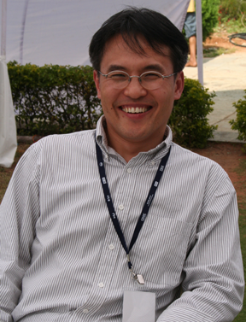
PRAGMA Leaders: Cloud/HPC Collaboration Workshop
Philip Papadopoulos
Director of UC Systems
San Diego Supercomputer Center
Virtualization and Software
Satoshi Sekiguchi
Deputy Director General,
Directorate for Information
Technology and Electronics at AIST
GeoGrid
Fang-Pang Lin
Group Lead Applications
NCHC
Telescience
Karpjoo Jeong, Director
Institute for Ubiquitous
Information Technology
And Application (UbITA)
Biosciences and Environment
Yoshio Tanaka, AIST
Principal Research Scientist
Lead, Grid Infrastructure Team
GEOGrid and Virtualization
Notes:
"Current Research Activities in Bio & Environmental Sciences at UBITA, Konkuk University"

Slide 6
Thank You
University of Hong Kong
Computer Centre HKU
All Participants

Slide 7
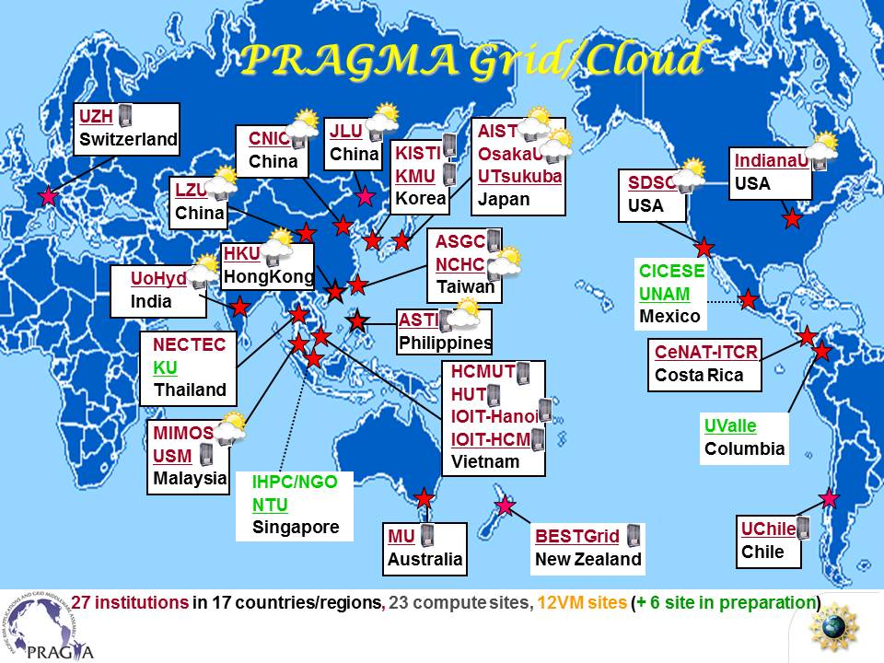
Infrastructure Accomplishments
Built testbed
  Used testbed to conduct experiments, test software
Developed approach to migrate images, multiple hosting environments
PRAGMA's multi-provider cloud.
GFarm is a strongly authenticated
VM repository

Slide 8
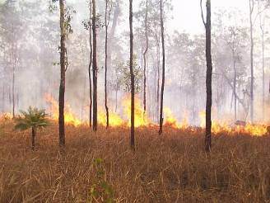
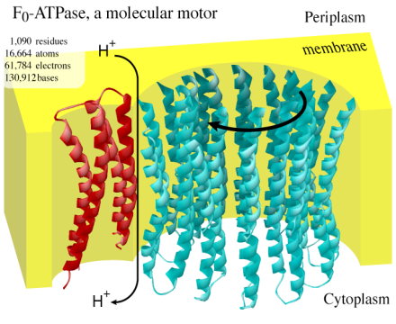
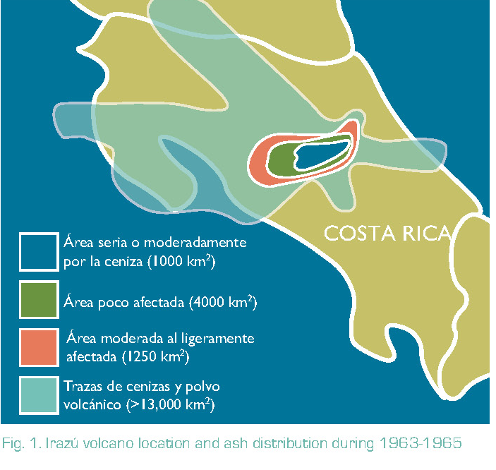
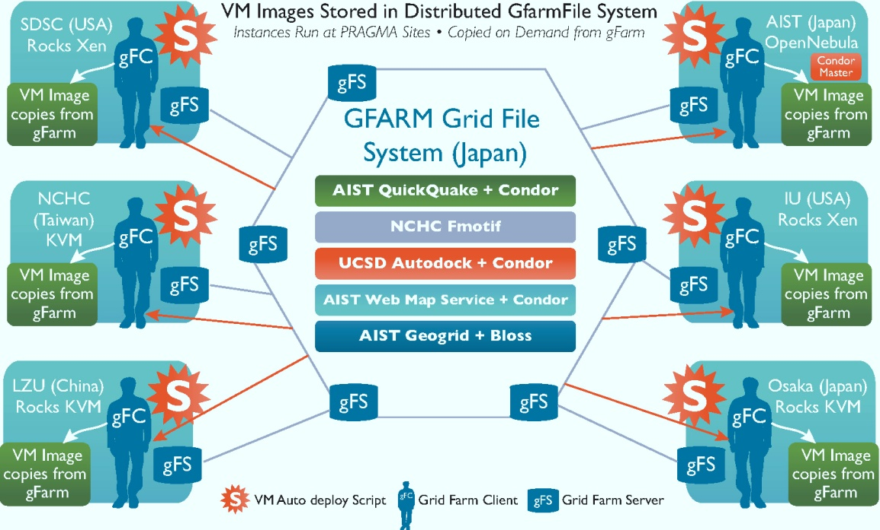
Scientific Expeditions
Evaluate and Address Needs of the Science
OSG Grid Interoperability
Experiment 2007
Savannah Burn 2006
Distribution of ash from
the Irazu volcano 2010
VM Migration
Experiment
2011
And improve
software
Notes:
Savannah Burn: An early expedition used the Nimrod middleware aid understanding the complex interactions of burning of a savannah on rain patterns via Monsoons in Australia, a great interest to water resources in Australia. The experiment initially used seven PRAGMA grid resources located in Australia, Japan, Korea, Taiwan, Thailand and the U.S. The results (POC 2006, p8; Lynch 2007) include scientific insights gained (confirming the hypothesis that under certain conditions burning the Savannah can affect the strength and timing of the monsoon); PRAGMA grid exercised (operated testbed for 170 days, delivered over 1.25 million processor hours, and allowed for upgrade of a number of the cyberinfrastructure components during the period); middleware improved (in particular to Nimrod's ability to schedule computations by incorporating both data location and transport delays); and policy on networking changed in Australia because of the amount of data moved (1.6 TB). I think we should move the expeditions approach into the overview – THIS is what we do – look at a scientific problem, evaluate the software needed to make it work, and then move forward – we should contrast the time it took to prepare the Savannah wildfire with our virtualization approach for geo grid.
Grid Interoperation Experiment with OSG: PRAGMA because grid interoperations with the Open Science Grid (OSG) in 2007, with an application provided by AIST, GridFMO, a Ninf-G grid implementation of the Fragment Molecular Orbital (FMO) method which enables a first-principle calculation of macromolecules. A series of GridFMO calculations ran on this combination of PRAGMA and OSG resources. A total of seven calculations were conducted from 2007/02/28 through 2007/05/18, utilizing a maximum of 240 CPUs. The fault-tolerance of GridFMO supported the stability of the calculations, each of which took 10 days on average. This produced meaningful and usable scientific results in a relatively short time. The experiment turned up two key challenges: security policies and job submission procedures (Ikegami 2007). (See PCO 2007, pp10-11).
Grid Interoperation Experiment (GIN): PRAGMA also lead some of the Grid Interoperations Now (GIN) effort out of the Open Grid Forum. This involved six grids: Australian Enterprise Grid, APAC Grid, PRAGMA Grid, FermiGrid, Open Science Grid (OSG), and the University of Zurich; middleware Nimrod-G; and the application of molecular replacement to test protein structures in the Protein Data Bank. This experiment identified five categories that the interop issues: Access and Security, Resource Discovery (e.g. monitoring tools to display aspects of remote systems – later incorporated in SCMSWeb), Usage Policies and Guidelines, Application Compatibility, and Middleware Compatibility (see Bethwaite 2008). The experiment generated more than seventy executions across the five Grids, requiring over half a million CPU hours. In addition, the experiment identified several proteins that were of medical interest. (See PCO 2008, p9).
Expanding to EC2: PRAGMA began to explore “virtualization” as an alternative, starting at PRAGMA 17 (Hanoi, 2009), and held a Virtualization and Implementation “institute” at PRAGMA 18 (San Diego, 2010). At that hands-on institute, an example of looking at ash distribution based on the NG-TEPHRA code. Understanding the distribution of ash from the Irazu volcano in the greater metropolitan area of San Jose is important for urban planning and disaster mitigation. The PRAGMA 18 workshop facilitated rapid prototyping of a PRAGMA Grid and Amazon EC2 cloud-based prototype driven by Nimrod/G, with subsequent work extending and modifying the original NG-TEPHRA model and code, making it suitable for large-scale distributed execution (Nunez 2010; PCO 2010 p 4). Furthermore a proposal was submitted to Amazon for completing this experiment.
VM Replication: Since PRAGMA 18 PRAGMA has also been looking at issues of interoperations of clouds. The first experiment was demonstrated at PRAGMA 19 (Jilin University, September 2010), where an application (Autodoc, part of the Avian Flu Grid software stack) was run across several different virtual machine hosting environments. The intent was to demonstrate that VM replication is a possible solution to achieve a “build once and run everywhere” environment. (See PCO 2010 page 6). In subsequent experiments, demonstrated at PRAGMA 20 (Hong Kong, March 2011) and PRAGMA 21 (AIST, October 2011) and later at SC11, we were able to automate the process of migrating virtual machine images between different hosting environments, expand the number of sites involved in the experiment, and migrate services between AIST and NCHC, and run some simulations at UCSD. (See PCO 2011 pp 7-8).
Disaster Recovery of Critical Services: After the March 11 earthquake and tsunami key services at AIST were disabled. Within a few days after the earthquake, the process began to migrate services including QuickQuake, Hot Spot and WMS Server onto the VM cluster at NCHC. In addition, UCSD (via SDSC’ Triton resource) generated the ground motion map of the March11 Tohoku Pacific Ocean Earthquake covering all of Japan to observe and analyze the earthquake. The movie is available on the GEO Grid Disaster Task Force website. Approximately 1500 jobs were submitted to Triton, each of which took 3-4 hours to process, utilizing one CPU. (See PCO 2011 pp 8 – 10). (Matsuoka 2011)

Slide 9
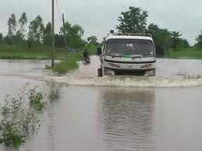
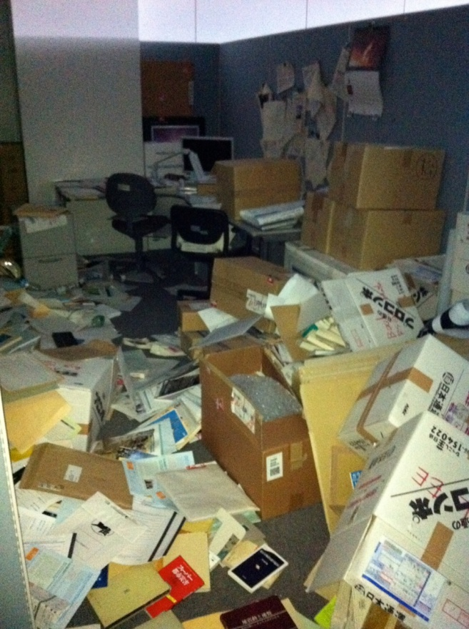
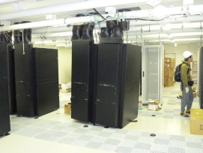

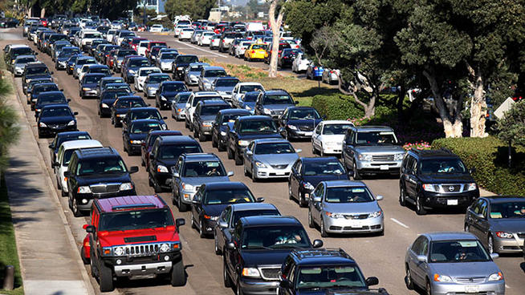
Disaster Recovery of Key Services
Massive earthquake and resulting tidal wave was devastating for Japan, AIST systems out of service
  NCHC, SDSC/UCSD, other institutions in Japan, and U Chicago (R Grossman) assistant, migrate services
Can PRAGMA members provide infrastructure to other members for this type of
persistence of key services at a
time of disruptions?
Notes:
NCHC: Naruto cluster, consisting of 16+1 nodes,
SDSC/UCSD: part of Triton resource

Slide 10
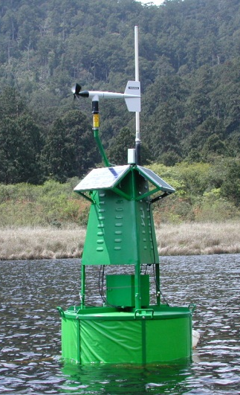
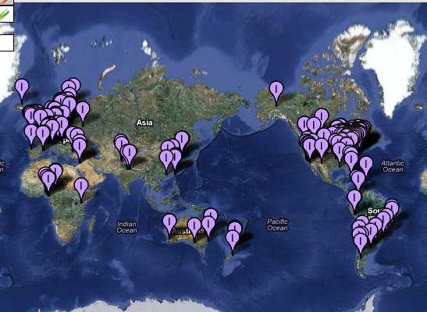
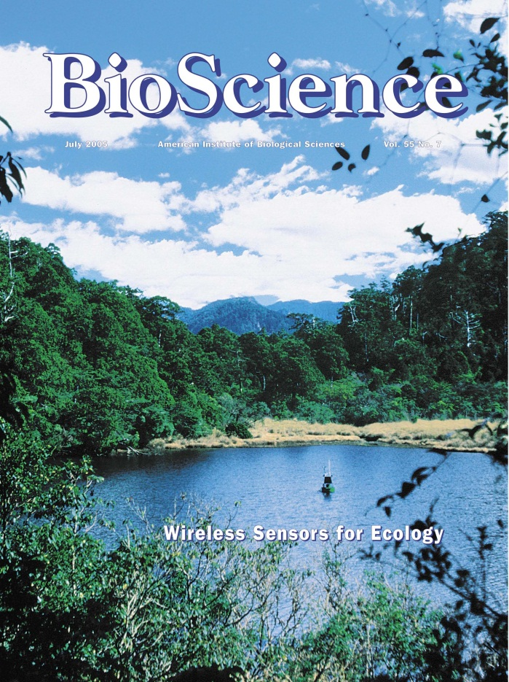
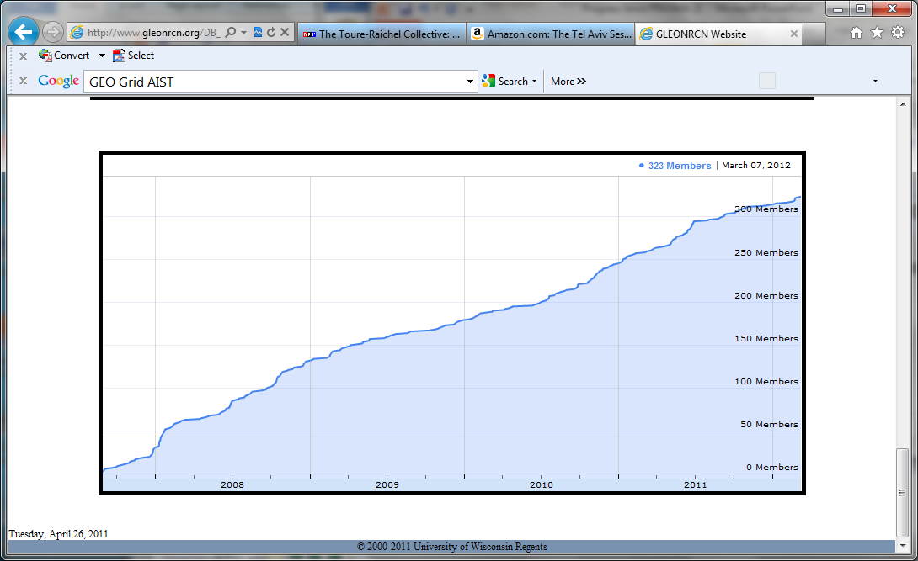

From Scientific Expedition to Community
Building on NCHC Ecogrid
8 Months: Concept to Deployment
Wireless Infrastructure (2004)
Science
Need more than one lake to understand processes
8 Years Later

Slide 11
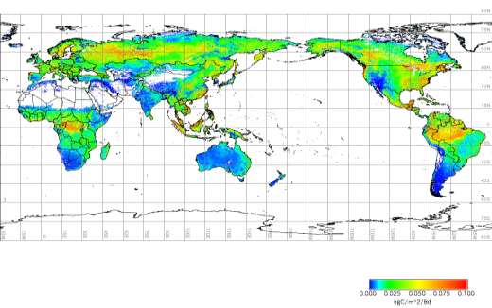

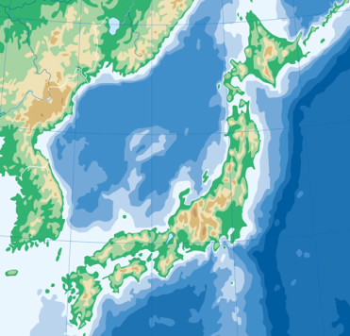
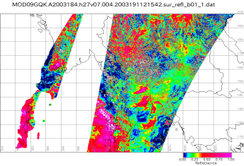
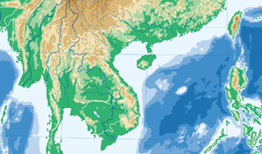
アプリケーションによるGEO Gridの評価
Asia GEO Grid Initiative
PI: Yoshio Tanaka (AIST)
Calibration of satellite
Data using in-situ data
Global CO₂ Map
１．Catalogue Search
２．Obtain data
３．Process data
４．visualize
Objective: To deploy Asia GEO Grid Infrastructure in Asia to share Earth observation data and computing resources for Earth sciences.
Thailand
Taiwan
Japan
Japan
Flux Data
Satellite Data
Thailand
AsiaFlux Network
Source: Y Tanaka

Slide 12
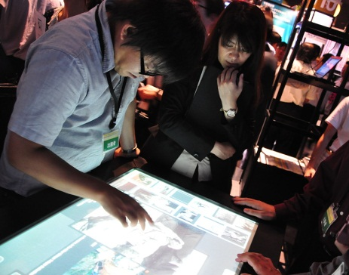
PRAGMA Advances by
Participants’ Collaborative Activities
GEO Grid: Hosted PRAGMA 21
  Led by AIST, involving NCHC, NECTEC, VAST/IOIT
Ezilla: NCHC
OpenFlow: Applying it by Osaka
Gfarm: U Tsukuba
Duckling, CNIC/CAS
My Gallery: Cultural Heritage Display, e.g., NICT, UCSD, MoPA
KLEON and KEON, Konkuk and others
Many more

Slide 13
Building on What We’ve been working on together: VMs + Overlay Networks + Data;
Infrastructure Developments
Data Sharing, Provenance, Data Valuation and Evolution Experiments:
  Beth Plale, Indiana U
Overlay Networks, Experiments with IPv6
  Jose Fortes, Renato Figueiredo, U Florida
VM Mechanics Multi-Site, Multi-Environment VM Control and Monitoring
  Phil Papadopoulos, UCSD
Sensor Activities: From Expeditions to Infrastructure
  Sameer Tilak, UCSD
NSF Proposal

Slide 14
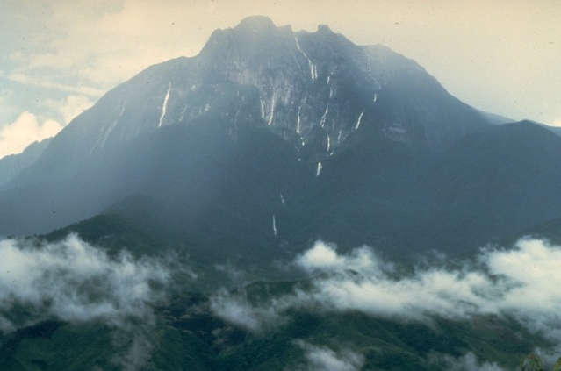
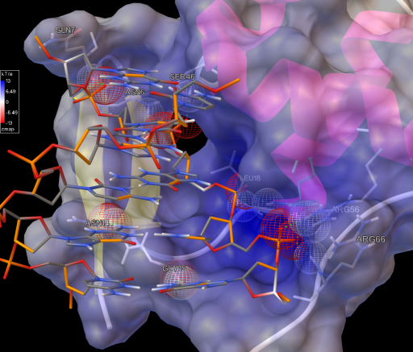
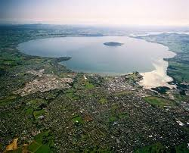
Future Scientific Expeditions
Proposed - Persistent
What Others?
Biodiversity
  Understanding Adaption in Extreme Ultramafic Regions: Reed Beaman U FL
Lake Science:
  Predicting Impact of Eutrophication on Lake Ecosystem Services: Paul Hanson, U Wisconsin
Drug Discovery:
  Focusing on Infectious Diseases: Wilfred Li, UCSD
Disaster Mitigation
Cultural Heritage Sharing
Many others
NSF Proposal
Notes:
Kinabalu – reed
Rotorua – web
Wendy Fong – with Wilfred – avian flu

Slide 15
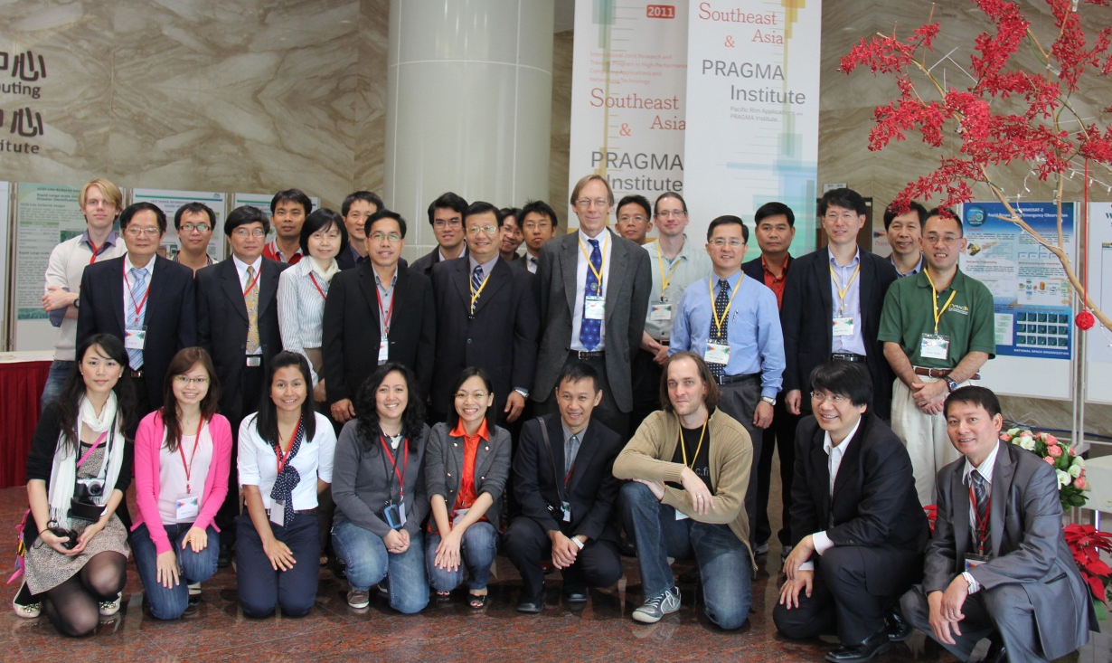
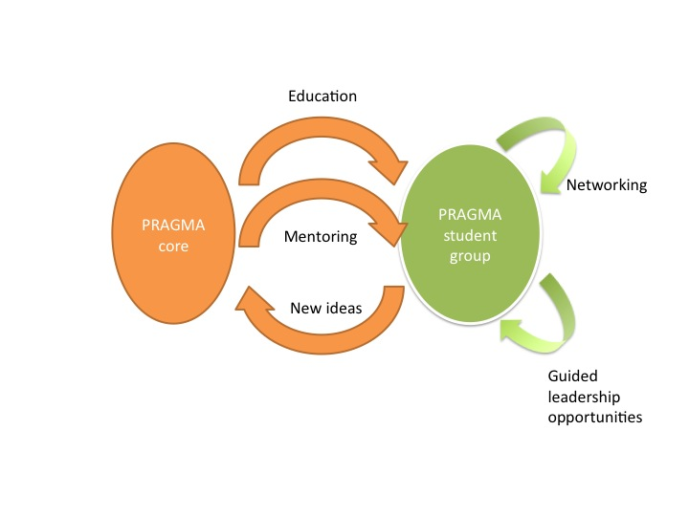
Infusing New Ideas: Strategic Partners
Growth in the past was mostly “community” driven
  SEAIP (Southeast Asia Institute International Joint Research and Training Program in High-Performance Computing Applications and Networking Technology) with the PRAGMA Institute
For our future, we need to consider expertise, impact, and growth opportunities
  New technology areas: Based on needs and areas we did not have represented
  New scientific expeditions: Exciting science, opportunity to engage more scientists, build communities
  New institutions/regions to engage
  New participants
  Students!: PRIME, GSA
    Building on PRIME
    Using GLEON model for students
NSF Proposal

Slide 16
PRAGMA Leaders: Cloud/HPC Collaboration Workshop
Philip Papadopoulos
Director of UC Systems
San Diego Supercomputer Center
Virtualization and Software
Satoshi Sekiguchi
Deputy Director General,
Directorate for Information
Technology and Electronics at AIST
GeoGrid
Fang-Pang Lin
Group Lead Applications
NCHC
Telescience
Karpjoo Jeong, Director
Institute for Ubiquitous
Information Technology
And Application (UbITA)
Biosciences and Environment
Yoshio Tanaka, AIST
Principal Research Scientist
Lead, Grid Infrastructure Team
GEOGrid and Virtualization
Notes:
"Current Research Activities in Bio & Environmental Sciences at UBITA, Konkuk University"

Slide 17
Collaborative Opportunities
Motivation
  New ideas
  Broader testbed
  Additional scientific expeditions
  Greater opportunities
Potential Areas
  Virtualization
    Compute
    Networking
  Environmental Observing and Monitoring Systems
  Disaster Recovery
  Biosciences
  Software development
PRAGMA 23 in Seoul, Korea
Host Konkuk University
9 – 11 October 2012

Slide 18
Other Collaborative Opportunities
China US Software Research
  Build collaborative research teams in software research
  http://www.nsf-nsfc-sw.org/
Open Source DataTurbine Initiative
  Develop technology for scaling sensor networks
  Real-time streaming data middleware for embedded and mobile computing applications
  http://www.dataturbine.org/
RCN4GSC (Genome Standards Consortium)
  From Genomes to Interactions to Communities to Models – held at BGI in Shenzhen 2012 March 4-7
  Beijing Meeting ????
  http://gensc.org/

Slide 19
Thank You
University of Hong Kong
Computer Centre HKU
All Participants

Slide 20
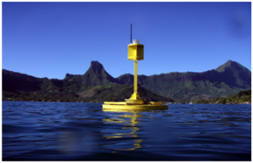
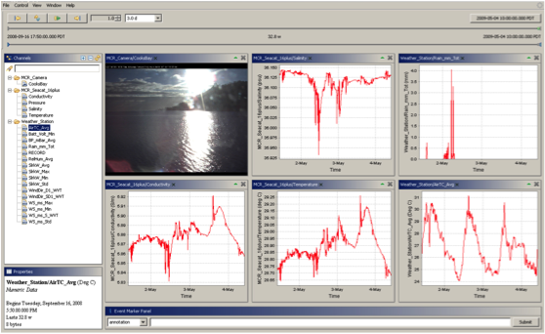
DataTurbine Streaming Data Middleware
Robust real-time streaming data engine for embedded and mobile computing applications
Stream live data from experiments, labs, web cams and even Java enabled cell phones
Acts as a "black box" to which applications and devices/sensors/instruments send and receive data
Scalable – runs on everything from embedded devices to supercomputers
Open source and freely available
  www.dataturbine.org

