Slide 1



Research Collaboration in Southern China: an Opportunity and Challenge
Workshop on Building Collaborations in Clouds, HPC, and Application Areas
July 2012, Hong Kong
Professor Yuguo Li
Department of Mechanical Engineering
The University of Hong Kong
Notes:
Dear Chairman, Ladies and Gentleman,
I’d like to thank the Technical Committee on Health Care Facilities for the opportunity to speak in this seminar.
Being in Hong Kong during the 2003 worldwide SARS epidemics and watching the development of the epidemic, we were naturally asking the question – what are the roles played by buildings in the epidemic?
The question was not easy to answer as the evidences for transmission routes disappeared RAPIDLY. We collected and published very probable evidences of airborne transmission in two major outbreaks in Hong Kong.
What is the implications to isolation room ventilation? Can we do better in the next influenza pandemic?

Slide 2
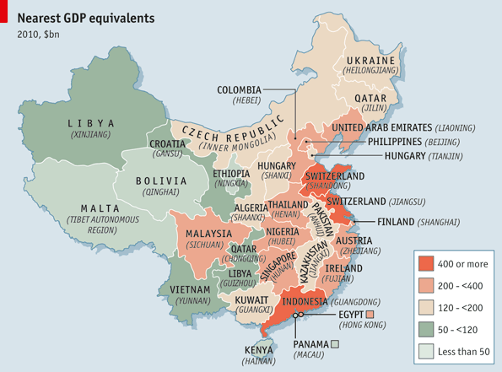
Mainland China is now the world’s second largest economy
Guangdong
Rank No 1 in total GDP (11.56%), RMB50k per capita in 2011, Tianjin, Beijing and Shanghai.
Foxconn is the largest electronics manufacture
Gree is the largest residential air-conditioner manufacturer
The world's largest supply base of
electric fans, rice cookers and microwave
Shenzhen
Home to some of the most successful high-tech companies in China, such as BYD, Dingoo, G'Five, Hasee, Huawei, JXD, Konka, Netac, Skyworth, Tencent and ZTE.
http://www.economist.com/node/18233380

Slide 3
Hong Kong economy has been transformed!
Hong Kong GDP by economic activity at current prices (%)

Slide 4
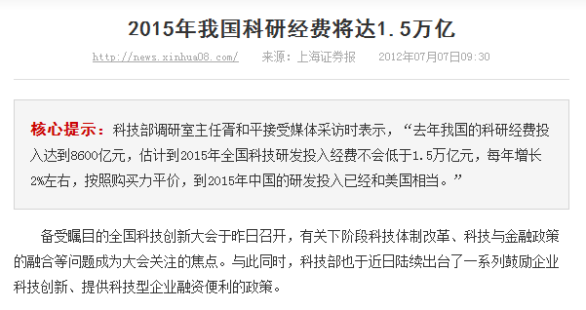
Contribution of manufacturing to GDP in 2010
Hong Kong <2%, Singapore 22% and Korea30%
R&D gross domestic expenditure and percentage of GDP in 2010
Hong Kong US$1.7 billion, 0.76% of GDP.
Singapore US$4.7 billion, 2.14% of GDP.
Rapid rise in R&D gross domestic expenditure in Mainland China
Ministry Sci & Tech: The total R&D budget in 2011 was RMB 860 billion, and expected to be RMB 1500 billion in 2015, similar to USA in terms of purchasing power parity.

Slide 5
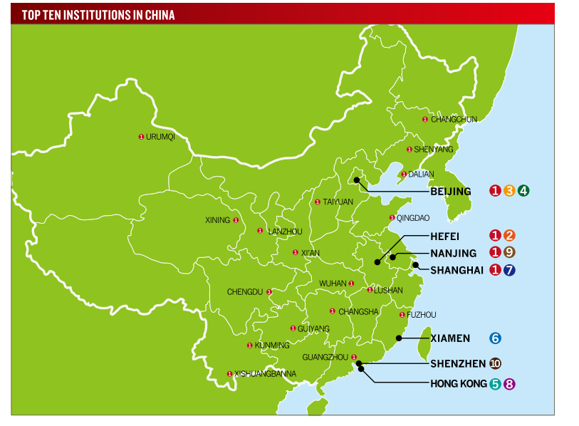
Potentials for research collaboration in Guangdong
C9 league Universities: None in Southern China region
5 among the 107 211 league universities, 2 among the 38 985 league Universities from Guangdong.
Zhongshan Uni and South China Uni of Sci & Tech among the top 30 postgraduate schools
Number of academicians: 30 from Guangdong, ranked No. 12 in 2008, behind Beijing (911), Shanghai (196) and even Shaanxi (53).
R&D expenditure ranking
in 2009: Jiangsu, Beijing,
Guangdong, Shandong,
Shanghai, Zhejiang,
totaling 58% of the nation
Nature Publishing Index 2011: China

Slide 6
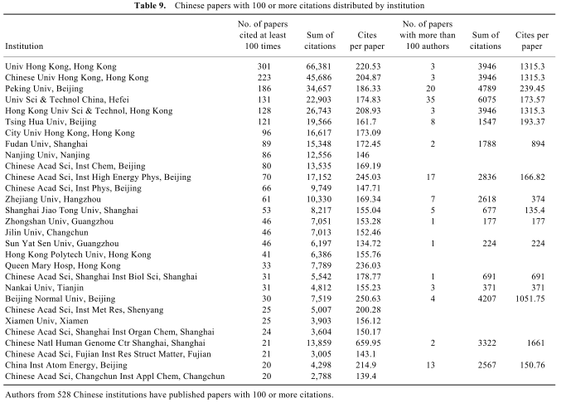
The strong research capacity of HKU – one indicator only
rr
Madhan et al., Highly cited papers from India and China, Current Science 99(6) 2010

Slide 7
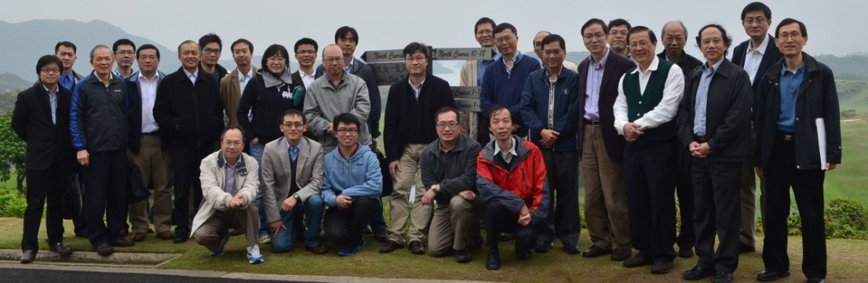
































HKU
Department of Mechanical Engineering
Mechanical Engineering was first taught in 1912. The first HKU Professor C A Middleton Smith was in Mechanical Engineering
1/3 full profs, 1/3 associate profs and 1/3 young colleagues.
We are at the forefront of research - engage in 7 of the 19 SRTs (Bionano, Energy, Environ etc) and we rank 4th at HKU in the top 1% citation list for the past 3 consecutive years.
Our laboratories been modernized– new MedE Labs, nano Labs, and new G/F manuf Labs
We focus on biomedical engineering, Nano-bio technology, Clean energy and environment, Robotics (new) and Computational science and engineering

Slide 8


Example 1: High-Performance Computing for air turbulence/pollution studies (Prof CH Liu)
Objective
  Study the transport of chemically reactive pollutants in the atmospheric boundary layer.
Methodology
  Large-eddy simulation (LES) & direct numerical simulation (DNS).
  Finite element method (FEM).
  Non-overlapping domain decomposition & MPI for message passing.
Collaborators
  Engineering Center, Shenzhen Institutes of Advanced Technology
    Fluid dynamics, turbulent chemistry & pollutant transport.
  Institute of Software Application Technology, Guangzhou & CAS
    Coding, parallel computing performance & algorithm.
Preliminary Findings
  Pollutant dispersion behaviors over different land surfaces are compared. A rapid dispersion is observed in rougher surface.
  Computing efficiency is examined by using different no. of cores. It is about 70% for almost 100 cores. Using more cores will be tried.

Slide 9
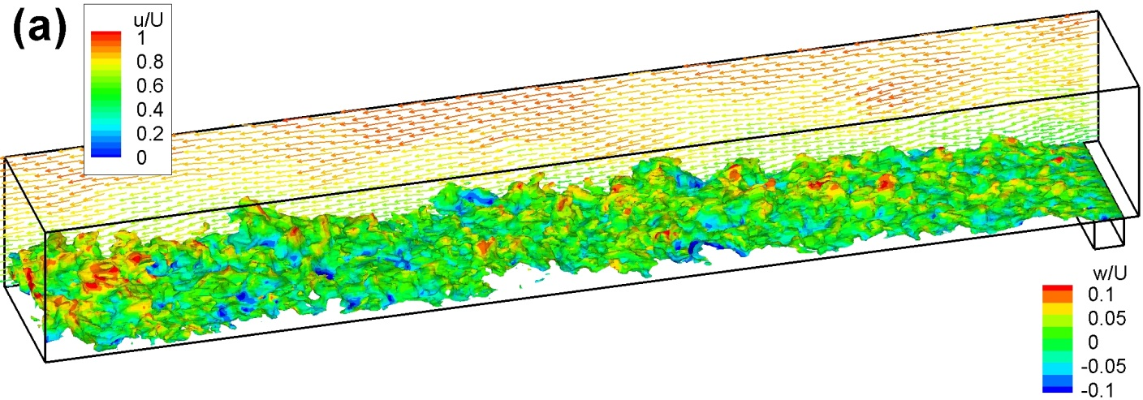
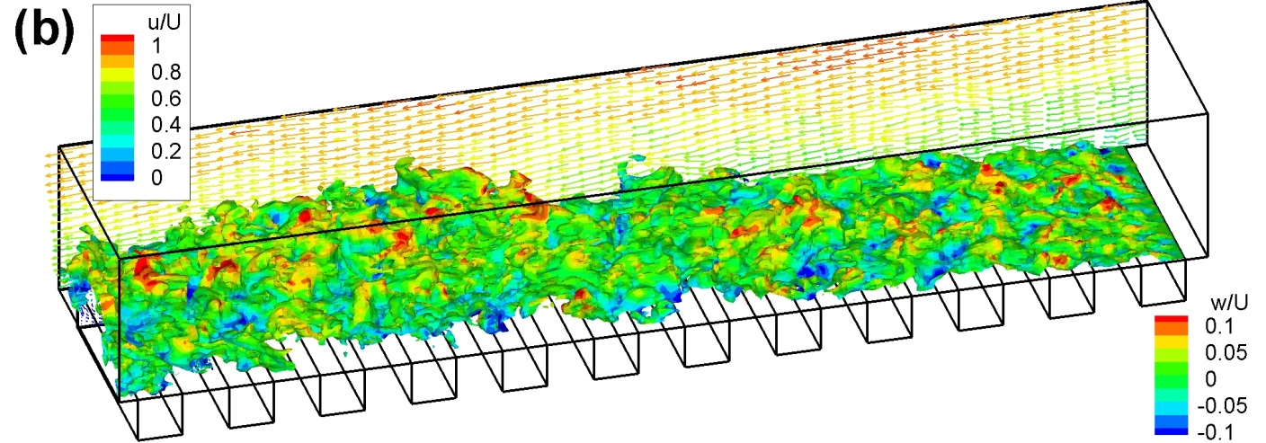
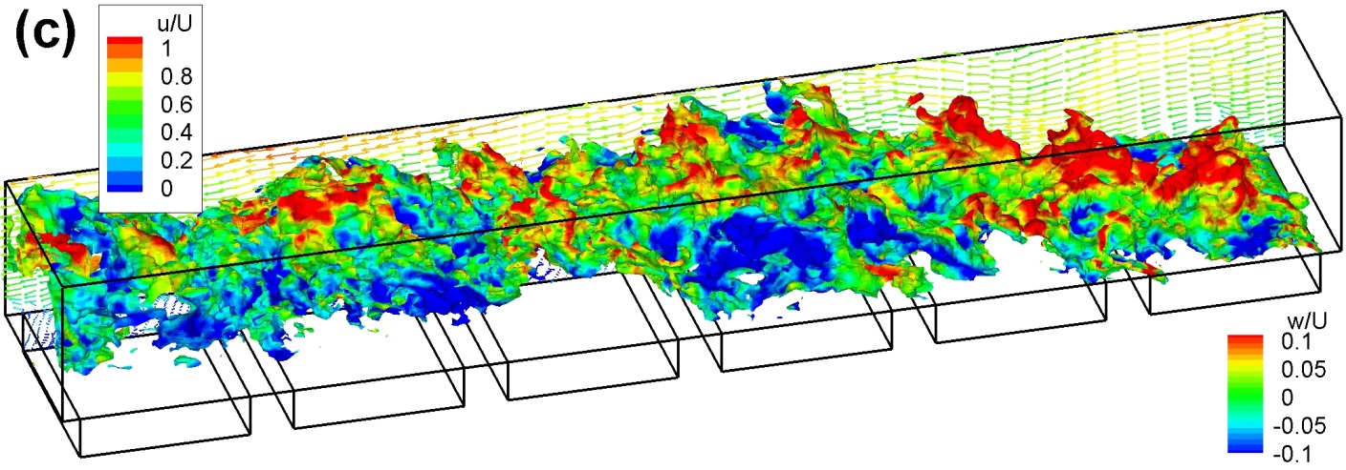
High-Performance Computing for air turbulence/pollution studies (Prof CH Liu)
A rapid plume dispersion is clearly depicted for rough a land surface

Slide 10
High-Performance Computing &
Air Turbulence/Pollution Studies

Slide 11
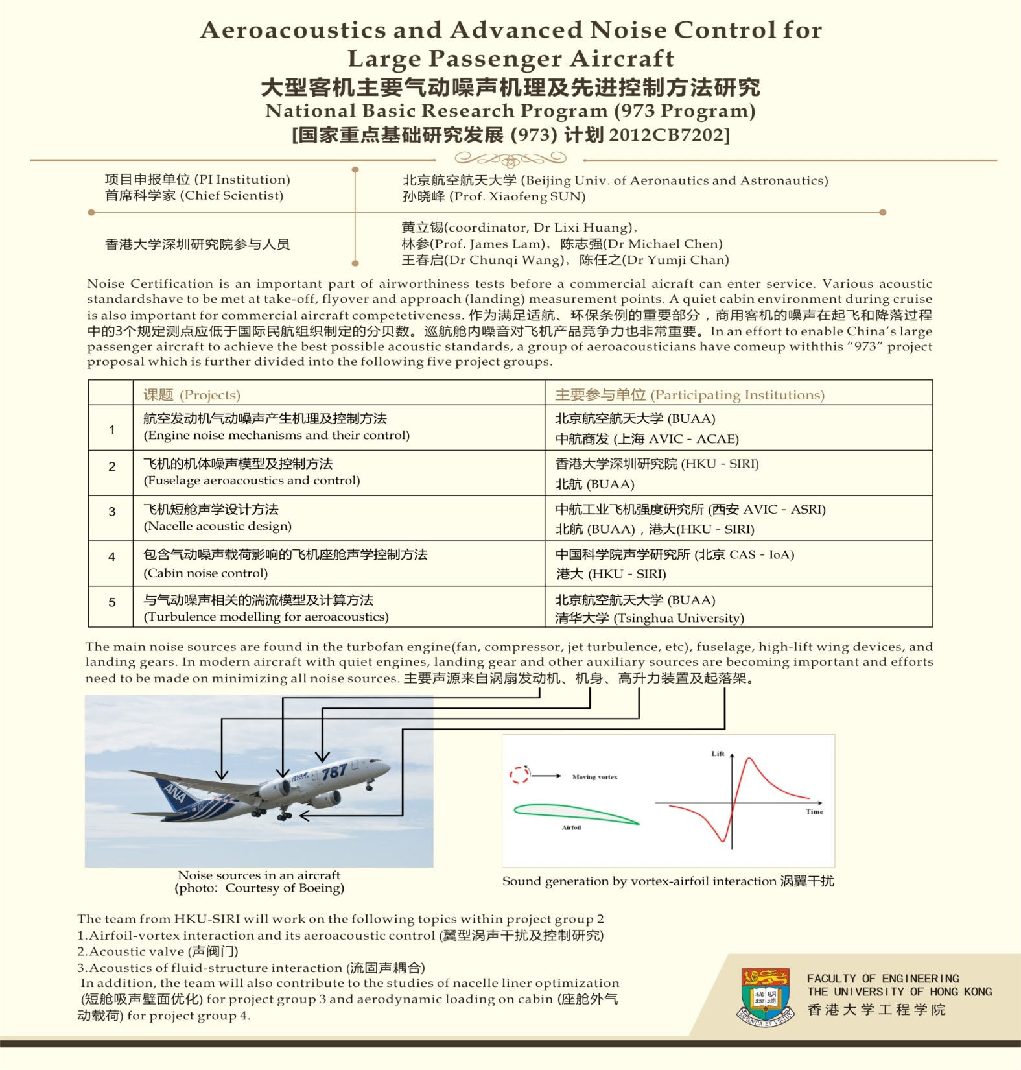
Example 2: (Prof Lixi Huang)

Slide 12
Example 3: Prof LQ Wang and Prof Lixi Huang
Zhejiang Institute of Research and Innovation (ZIRI)
HKU ME Noise and Aerodynamics Lab
HKU ME Nanofluid and heat transfer Lab
Zhejiang and local Governments provide RMB 30 million for 5 years for each lab.
The focus will be on the research and development, not on fundamental research.

Slide 13
Collaboration opportunities in Mech Eng
Critical challenges including energy, environment, resources, rapid urbanization and rapid knowledge expansion
Urgent need for mechanical engineers worldwide to develop innovative and break-through engineering solutions for a sustainable, cleaner, safer and healthier world
These new critical challenges are particularly essential to China.
China manufacturing products （机械工业产业总值） at US$2 trillion in 2010, become No 1 in the world according to HIS Global Insight, however, now in productivity (US 11 million works and China 100 million).

Slide 14
Research collaboration in Southern China
- a historical opportunity for us
Challenges in recognizing this historical opportunity and the differences in HR and finance systems, which may be turned into a great opportunity for mutual learning.
There have already been a lot of collaboration activities between HK and Guangdong Universities – just visit our RA offices, and ITF Guangdong-HK Tech Cooperation Funding Scheme (TCFS).
Urgent need for harmonizing finance, HR and research policies to achieve frictionless movement of researchers, rpg students, facilities/instrument and research fund – needs HKSAR/Guangdong Govts (Note that HK business community has been in PRD for the past 30 years).
Need for understanding of National strategic research needs by the Hong Kong researchers, shift from publication-focused research to multi-faceted research, next generation of HK trained researchers of in-depth understanding of both HK and PRD economy.

Slide 15

Thank you

