Slide 1
Virtualization in PRAGMA and Software Collaborations
Philip Papadopoulos (University of California San Diego, USA)

Slide 2
Remember the Grid Promise?
The Grid is an emerging infrastructure that will fundamentally change the way we think about-and use-computing. The word Grid is used by analogy with the electric power grid, which provides pervasive access to electricity and has had a dramatic impact on human capabilities and society
The grid: blueprint for a new computing infrastructure,
Foster, Kesselman. From Preface of first edition, Aug 1998

Slide 3
Some Things that Happened on the Way to Cloud Computing
Web Version 1.0 (1995)
1 Cluster on Top 500 (June 1998)
Dot Com Bust (2000)
Clusters > 50% of Top 500 (June 2004)
Web Version 2.0 (2004)
Cloud Computing (EC2 Beta - 2006)
Clusters > 80% of Top 500 (Nov. 2008)

Slide 4
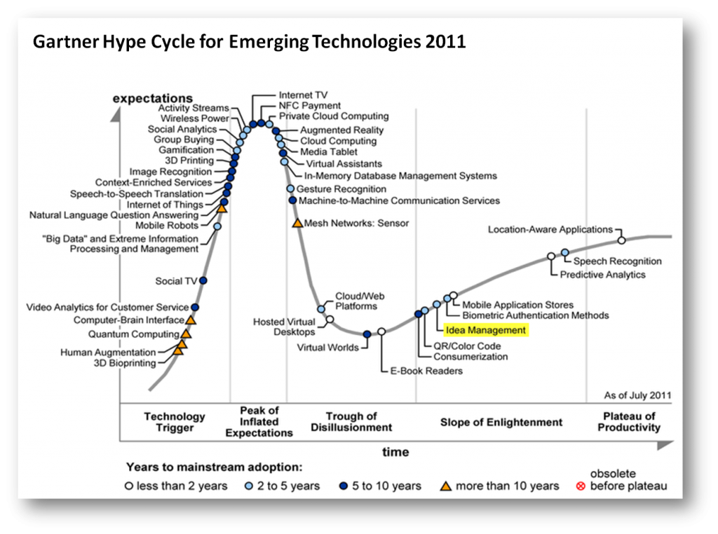

Slide 5
What is fundamentally different about Cloud computing vs. Grid Computing
Cloud computing – You adapt the infrastructure to your application
  Should be less time consuming
Grid computing – you adapt your application to the infrastructure
  Generally is more time consuming
Cloud computing has a financial model that seems to work – grid never had a financial model
  The Grid “Barter” economy only valid for provider-to-provider trade. Pure consumers had no bargaining power

Slide 6
Cloud Hype
“Others do all the hard work for you”
“You never have to manage hardware again”
“It’s always more efficient to outsource”
“You can have a cluster in 8 clicks of the mouse”
“It’s infinitely scalable”
…

Slide 7
Observations
“Cloud” is now far enough along that we
  Invest time to understand how to best utilize it
  Fill in gaps in specific technology to make it easier
  Think about scale for parallel scientific Apps
Virtual computing has gained enough acceptance that
  It should be around for a while
  Can be thought of as closer to “electricity”
→ We are first focusing on IAAS (infrastructure) clouds like EC2, Eucalyptus, OpenNebula, …

Slide 8
One BIG Problem: too many choices

Slide 9
Really of Collaboration: People and Science are Distributed
PRAGMA – Pacific Rim Applications and Grid Middleware Assembly
  Scientists are from different countries
  Data is distributed
Use Cyber Infrastructure to enable collaboration
When scientists are using the same software on the same data
  Infrastructure is no longer in the way
  It needs to be their software (not my software)

Slide 10

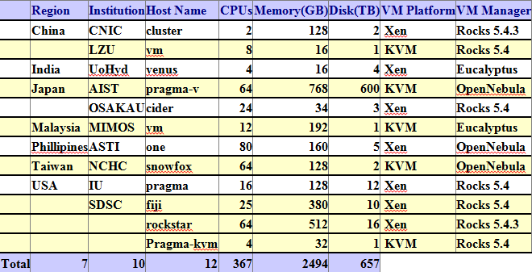
PRAGMA’s Distributed Infrastructure Grid/Clouds
UZH
Switzerland
UZH
Switzerland
CNIC
China
JLU
China
AIST
OsakaU
UTsukuba
Japan
KISTI
KMU
Korea
IndianaU
USA
LZU
China
SDSC
USA
LZU
China
ASGC
NCHC
Taiwan
HKU
HongKong
UoHyd
India
ASTI
Philippines
NECTEC
KU
Thailand
CeNAT-ITCR
Costa Rica
HCMUT
HUT
IOIT-Hanoi
IOIT-HCM
Vietnam
MIMOS
USM
Malaysia
UValle
Colombia
MU
Australia
BESTGrid
New Zealand
UChile
Chile
26 institutions in 17 countries/regions, 23 compute sites, 10VM sites

Slide 11
Can PRAGMA do the following?
Enable Specialized Applications to run easily on distributed resources
Investigate Virtualization as a practical mechanism
  Multiple VM Infrastructures (Xen, KVM, OpenNebula, Rocks, WebOS, EC2)
Use Geogrid Applications as a first driver of the process

Slide 12
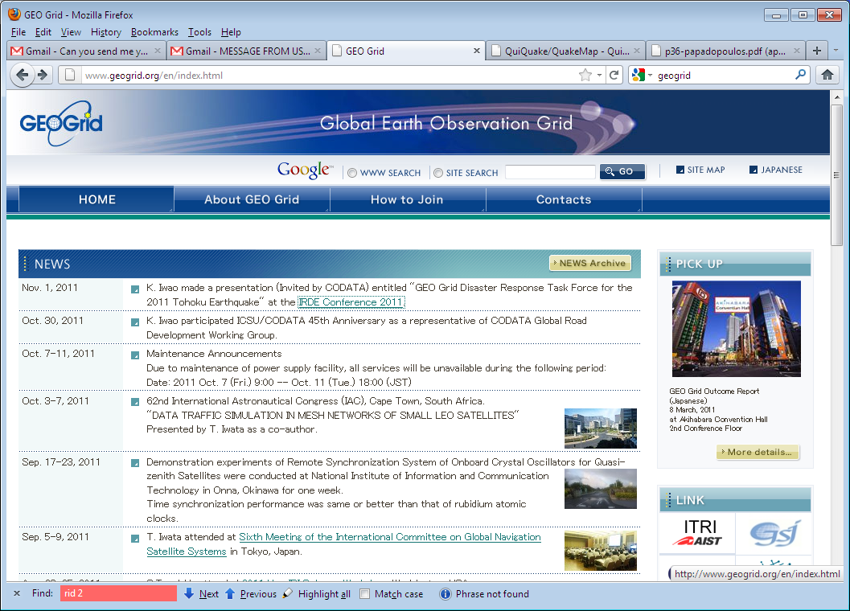
Use GeoGrid Applications as a Driver
I am not part of GeoGrid, but PRAGMA members are!

Slide 13
Deploy Three Different Software Stacks on the PRAGMA Cloud
QuiQuake
  Simulator of ground motion map when earthquake occurs
  Invoked when big earthquake occurs
HotSpot
  Find high temperature area from Satellite
  Run daily basis (when ASTER data arrives from NASA)
WMS server
  Provides satellite images via WMS protocol
  Run daily basis, but the number of requests is not stable.
Source: Dr. Yoshio Tanaka, AIST, Japan

Slide 14
What are the Essential Steps
AIST/Geogrid creates their VM image
Image made available in “centralized” storage
PRAGMA sites copy Geogrid images to local clouds
  Assign IP addresses
  What happens if image is in KVM and site is Xen?
Modified images are booted
Geogrid infrastructure now ready to use

Slide 15



VM Deployment Phase I - Manual
http://goc.pragma-grid.net/mediawiki-1.16.2/index.php/Bloss%2BGeoGrid
# rocks add host vm container=…
# rocks set host interface subnet …
# rocks set host interface ip …
# rocks list host interface …
# rocks list host vm … showdisks=yes
# cd /state/partition1/xen/disks
# wget http://www.apgrid.org/frontend...
# gunzip geobloss.hda.gz
# lomount –diskimage geobloss.hda -partition1 /media
# vi /media/boot/grub/grub.conf
…
# vi /media/etc/sysconfig/networkscripts/ifc…
…
# vi /media/etc/sysconfig/network
…
# vi /media/etc/resolv.conf
…
# vi /etc/hosts
…
# vi /etc/auto.home
…
# vi /media/root/.ssh/authorized_keys
…
# umount /media
# rocks set host boot action=os …
# Rocks start host vm geobloss…
Website
Geogrid
+ Bloss
Geogrid
+ Bloss
VM devel
server
frontend
Geogrid + Bloss
vm-container-0-0
vm-container-0-1
PRAGMA
Early 2011
vm-container-0-2
vm-container-….
VM hosting server

Slide 16
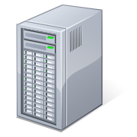






Centralized VM Image Repository
VM images
depository and sharing
Gfarm Client
vmdb.txt
Gfarm meta-server
Gfarm file server
Geogrid + Bloss
Fmotif
Nyouga
QuickQuake
Gfarm file server
Gfarm file server
Gfarm file server
Gfarm Client
Gfarm file server
Gfarm file server

Slide 17
VM Deployment Phase II - Automated
http://goc.pragma-grid.net/mediawiki-1.16.2/index.php/VM_deployment_script
$ vm-deploy quiquake vm-container-0-2
Quiquake
PRAGMA
Late 2011
Gfarm
Client
VM development server
frontend
S
vm-deploy
Quiquake
vm-container-0-0
Fmotif
Nyouga
vm-container-0-1
vmdb.txt
Geogrid + Bloss
vm-container-0-2
quiquake, xen-kvm,AIST/quiquake.img.gz,…
Fmotif,kvm,NCHC/fmotif.hda.gz,…
Gfarm
Client
Quiquake
vm-container-….
Gfarm Cloud
VM hosting server

Slide 18
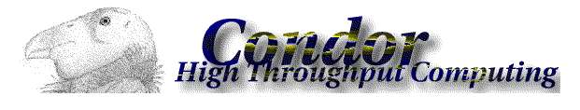
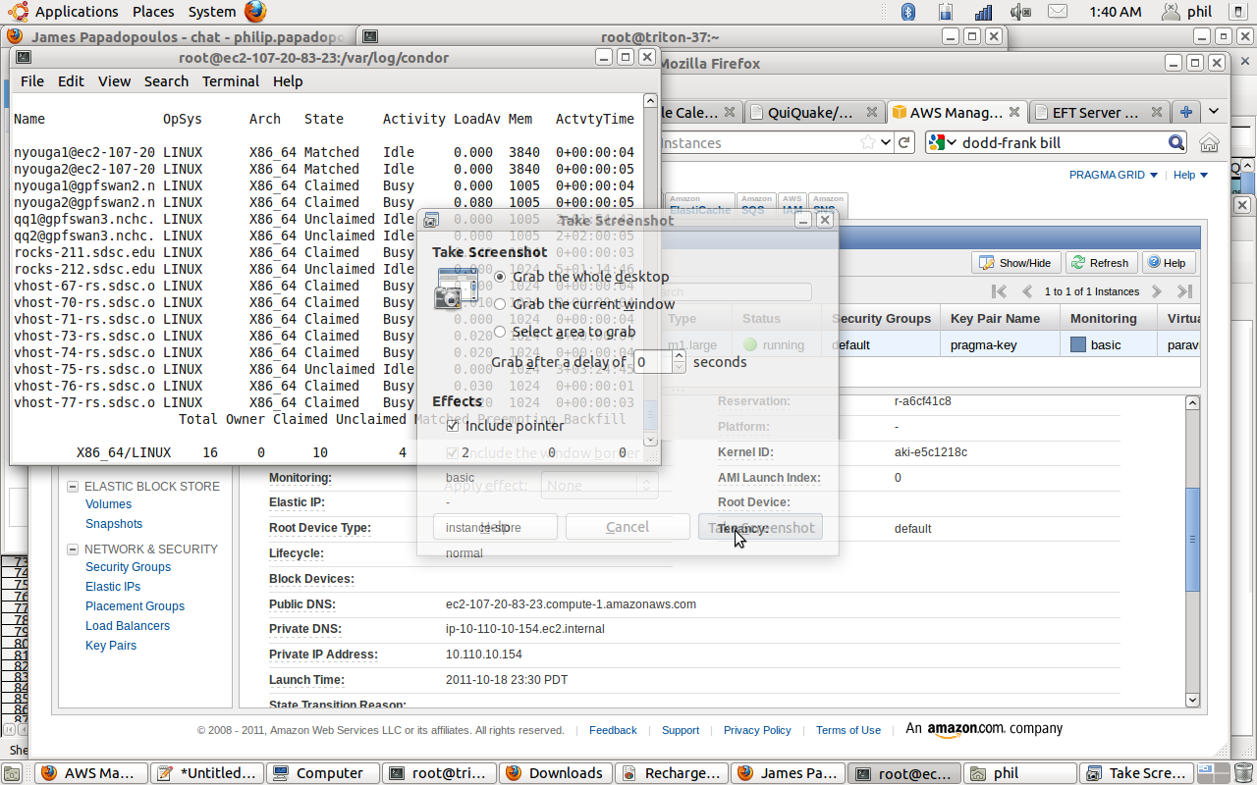
Condor Pool + EC2 Web Interface
4 different private clusters
1 EC2 Data Center
Controlled from Condor Manager in AIST, Japan

Slide 19
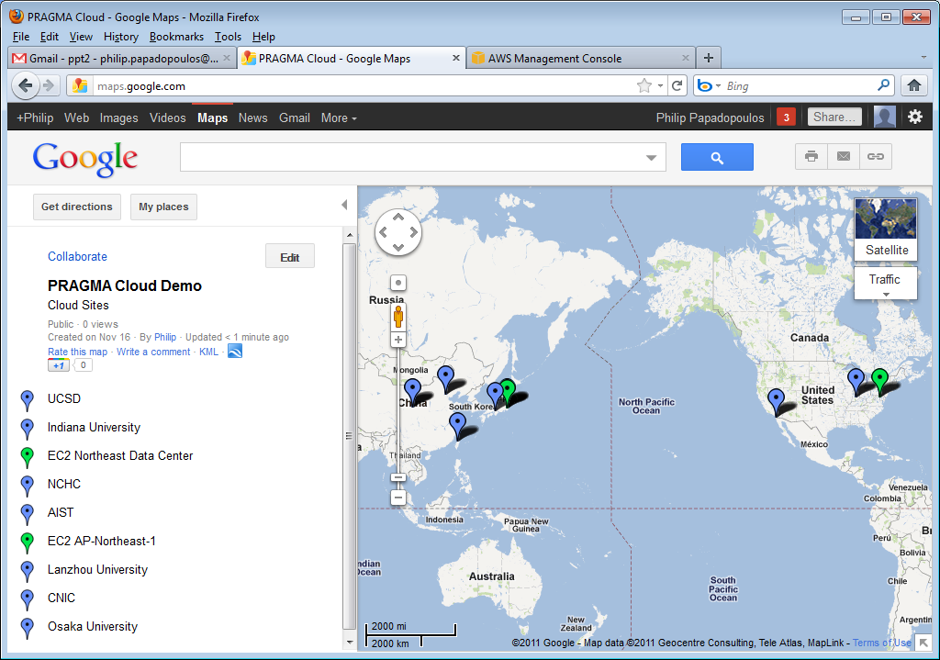
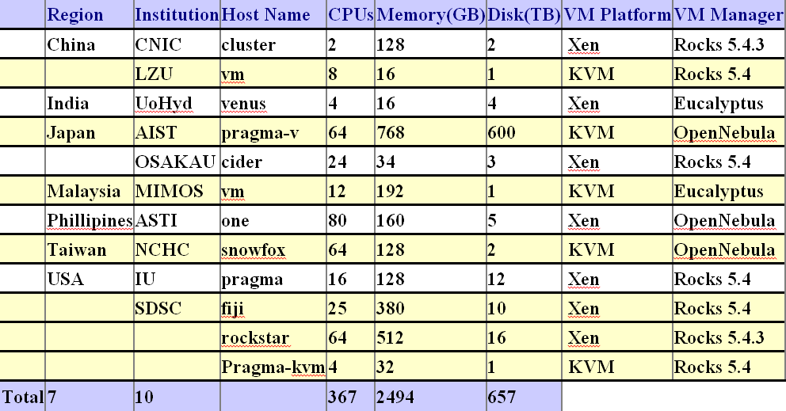
Cloud Sites Integrated in Geogrid Execution Pool
PRAGMA Compute Cloud
JLU
China
AIST
OsakaU
Japan
CNIC
China
IndianaU
USA
LZU
China
LZU
China
NCHC
Taiwan
SDSC
USA
UoHyd
India
ASTI
Philippines
MIMOS
Malaysia

Slide 20
Roles of Each Site PRAGMA+Geogrid
AIST – Application driver with natural distributed computing/people setup
NCHC – Authoring of VMs in a familiar web environment. Significant Diversity of VM infra
UCSD – Lower-level details of automating VM “fixup” and rebundling for EC2
We are all founding members of PRAGMA

Slide 21
Rolling Forward
Each stage, we learn more
We can deploy Scientific VMs across resources in the PRAGMA cloud, but
  Networking is difficult
  Data is vitally important
→ PRAGMA Renewal Proposal and Enhanced Infrastructure

Slide 22
Proposal to NSF to Support US Researchers in PRAGMA
Shared
Experimentation
Building on
Our Successes
Driving Development
Persistent, Transitory
Infusing New Ideas
Notes:
Builds on the strong collaboration we have built up over the past 10 years
Proposes an exciting approach to building and learning from an experimental multi-provider cloud test bed
Engages important scientific drivers of broad interest through what we call scientific expeditions
Creates opportunities for students to be engaged in PRAGMA, to build their professional networks, to create the next generation of researchers, and to bring in new ideas
Focuses on building the partnership in strategic areas/regions
Expands the number of US institutions involved in PRAGMA, and brings in new areas of expertise and applications

Slide 23
Driven by “Scientific Expeditions”
Expedition: focus on putting distributed infrastructure builders and application scientists together
Our proposal described three specific scientific expedition areas for US participation:
  Biodiversity (U. Florida, Reed Beaman)
  Global Lake Ecology (U. Wisc, Paul Hansen)
  Computer Aided Drug Discovery (UCSD, Arzberger + )
IMPORTANT: Our proposal could describe only some of the drivers and infrastructure that PRAGMA works on together as a group

Slide 24
“Infrastructure” Development and Support. Significant Expansion in # of US
Data Sharing, Provenance, Data Valuation and Evolution Experiments:
  Beth Plale, Indiana U
Overlay Networks, Experiments with IPv6 10
  Jose Fortes, Renato Figueiredo, U Florida
VM Mechanics Multi-Site, Multi-Environment VM Control and Monitoring
  Phil Papadopoulos, UCSD
Sensor Activities: From Expeditions to Infrastructure
  Sameer Tilak, UCSD
Notes:
Savannah
Costa Rica
Materials Science
Computational Chemistry

Slide 25
Building on What We’ve been working on together: VMs + Overlay Networks + Data

Slide 26
Add Overlay Networking
In Our Proposal
  Led by U Florida (Jose’ Fortes, Renato Figueiredo) (VinE and IPOP)
  Extend to IPV6 Overlays
Not in our proposal but we are already supporting experiments
  OpenVswitch led Osaka, AIST (PRAGMA Demos, March 2012)
Virtual Network architecture based on deployment of user-level virtual routers (VRs). Multiple mutually independent virtual networks can be overlaid on top of the Internet. VRs control virtual network traffic, and transparently perform firewall traversal

Slide 27
Refine Focus on Data Products and Sensing
Data Integration and tracking how data evolves in PRAGMA
  Led by Beth Plale, Indiana University
  “develop analytics and provenance capture techniques that result in data valuation metrics that can be used to make decisions about which data objects should be preserved over the long term and which that should not”
Sensor data infrastructure
  Led By Sameer Tilak, UCSD
  utilize the proposed PRAGMA infrastructure as an ideal resource to evaluate and advance sensor network cyberinfrastructure.
  Capitalizes on established history of working across PRAGMA and GLEON (with NCHC, Thailand, and others)

Slide 28
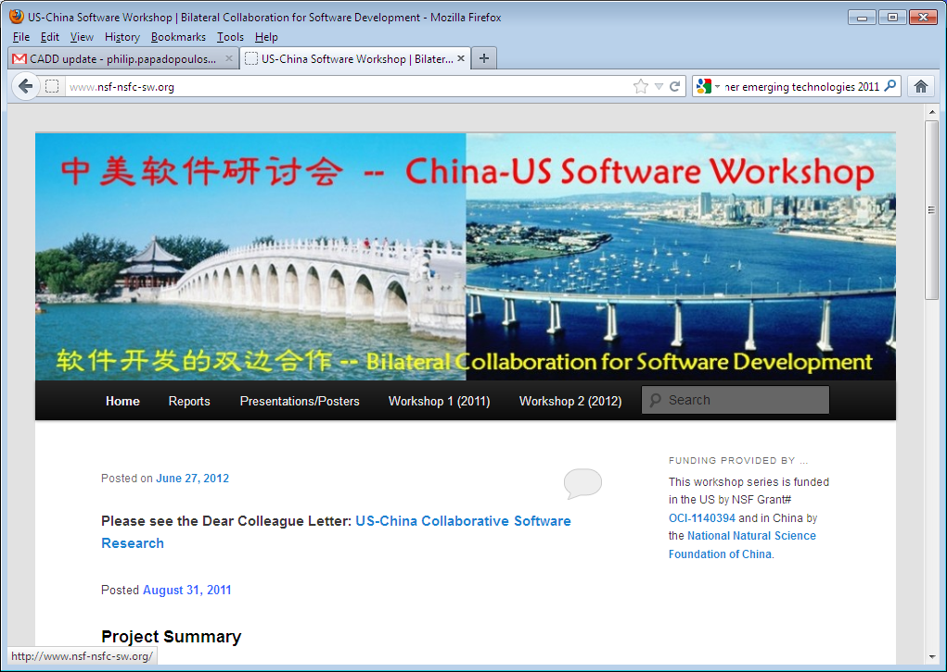
Other Opportunities: US-China Specific

Slide 29
Workshop Series
Two Workshops
  Sep 2011 (Beijing)
  March 2012 (San Diego)
  Approximately 40 participants at each Workshop
Explore how to catalyze collaborative software development between US and China
  Exascale Software
  Trustworthy Software
  Software for Emerging Hardware Architectures

Slide 30
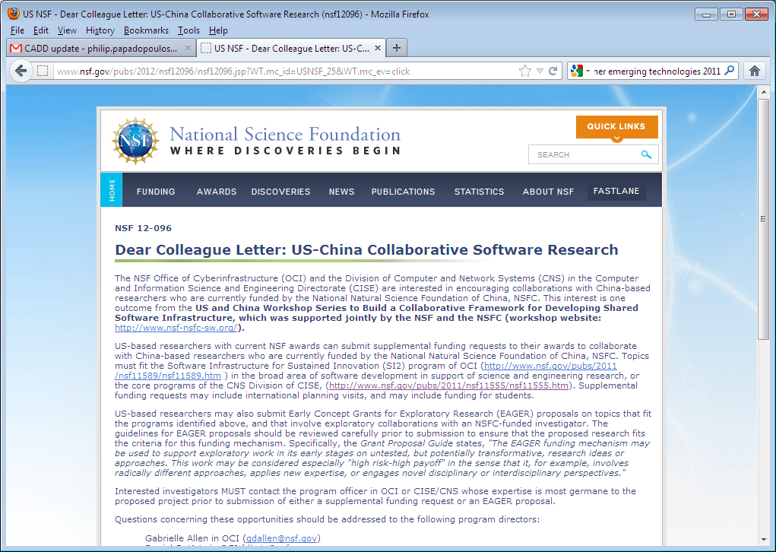
Start of a more formal approach to bilateral collaboration

Slide 31
Thank you!

