Slide 1
Cloud and Technical Computing at ASTRI
Exploratory Research Laboratory, ASTRI

Slide 2
Agenda
ASTRI ICT R&D center
Technical Computing activities at ASTRI
Computing resources at ASTRI
R&D activities for Cloud and Technical Computing

Slide 3
ASTRI as an ICT R&D center
Technical Computing activities at ASTRI
Computing resources at ASTRI
R&D activities for Cloud and Technical Computing

Slide 4
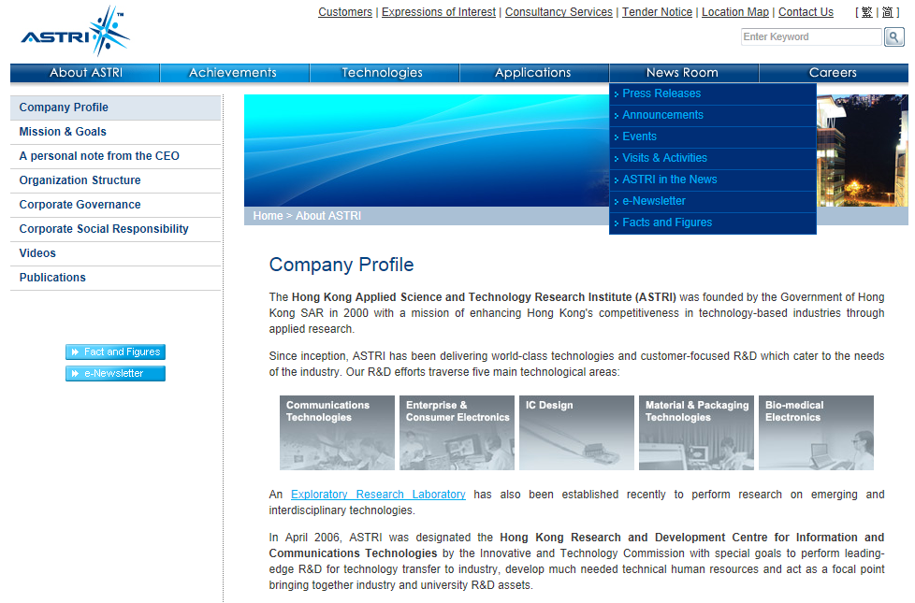
ASTRI as an ICT R&D center
Founded by Government of Hong Kong SAR in 2000 with a mission of enhancing Kong Kong’s competitiveness in technology-based industries through applied research.
4 large groups and 2 small groups.
Communication Technologies
Enterprise & Consumer Electronics
IC Design
Material & Packaging Technologies
Bio-medical Electronics
Exploratory Research Laboratory

Slide 5
ASTRI ICT R&D center
Technical Computing activities at ASTRI
Computing resources at ASTRI
R&D activities for Cloud and Technical Computing

Slide 6
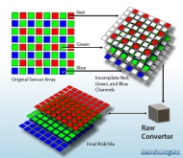
Technical Computing activities at ASTRI
Technical computing is used in many areas.
Enterprise computing
Virtual Desktop Infrastructure, CRM & ERP system, e-mail system, intranet web-service system…
IC design and simulation
Analog , digital , and mixed signal circuit designs, using hspice, ncverilog, simvision, etc…
Fused deposition Modeling
Multi-layer PCB board fabrication.
Digital pathology
Conversion, management, viewing and analyzing of digitized microscopic images.
Image & video processing
Some projects requires image and video processing power, such as codec, compression, video streaming, etc…
Network simulation, wireless communication, antenna design simulation
Matlab, ns2, etc…
Data mining
Manage and analyze big unstructured data to help decision-making

Slide 7
ASTRI ICT R&D center
Technical Computing activities at ASTRI
Computing resources at ASTRI
R&D activities for Cloud and Technical Computing

Slide 8
Computing Resources at ASTRI
Currently, there are many independent clusters, each administered by its own team. They are typical x86 servers from Dell, HP or IBM.
Group A
Group B
Group C
Group n
Typical servers:
ICD :
2 x Intel Xeon processor @ 2.9GHz
96G RAM
1Gbps Ethernet adapter
IT system:
2 x Intel Xeon processor @ 2.4GHz
48G RAM
1Gbps Ethernet adapter
4/8G FC storage controller

Slide 9
Computing Resource Provision at ASTRI (cont)
Opportunity to optimize resource utilization by consolidating existing and new clusters into a cloud-based technical computing platform
Group A
Group B
Group C
Group n
Hosts for special requirements
Cloud Infrastructure

Slide 10
ASTRI ICT R&D center
Technical Computing activities at ASTRI
Computing resources at ASTRI
R&D activities for Cloud and Technical Computing

Slide 11
R&D activities for Cloud & Technical computing
ASTRI’s interests in Cloud and Technical computing technologies:
IaaS platform
Secured and privacy protected cloud-based storage
Cloud-based application, SaaS/PaaS, also mobile apps.
Industry/business sector clouds
Peering technology and standards
Big data analytics, social media
P2P mobile service platform
IOT platform
Android Digital Home platform
E-education

Slide 12
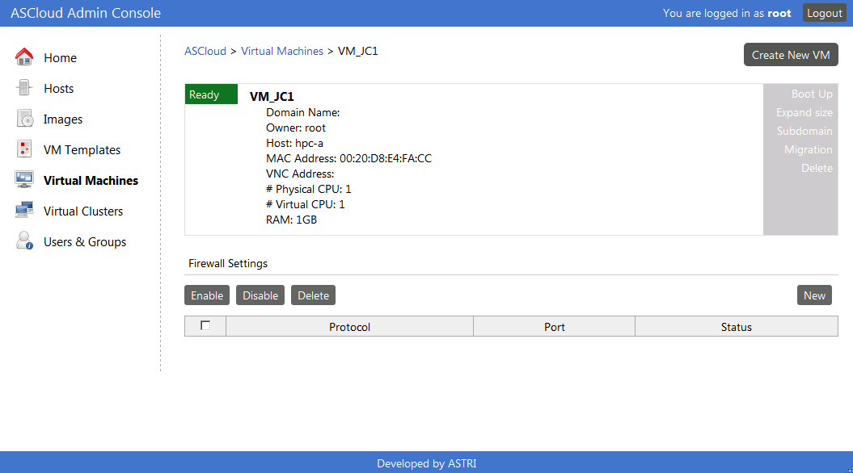
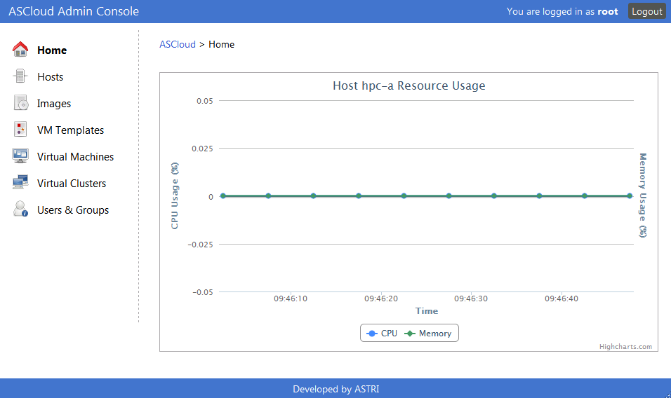
IaaS Cloud Platform - ASCloud
General purpose virtual machine service platform:
VM provision
Resource monitoring
Dynamic scheduling and live migration
Virtual Firewall
Easy data transferring and secured storage
Friendly user and administrator interface
Low system requirement, cost-effective and high scalability
Standard compliance
Test-bed for various projects
Cost-effective alternative to expensive leading commercial software
12
Notes:
Team COMPETENCY

Slide 13
Thank you !

